Slide 1
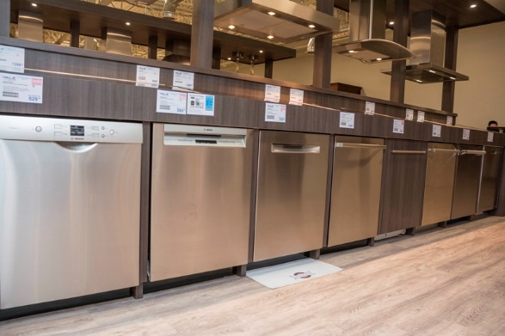
Solution to HW10

Slide 2
Q1 – Q5 … dishwashers

Slide 3
Data for 542 dishwashers:
Noise: average = 53.559 dB, SD = 5.909 dB
Price: average = $838.45, SD = $372.03
r = –0.80785
Regression results (from formulas):
Predicted price = 3562.58 – 50.862*noise
(86.044) (1.597)
SE_{Y|X} = $219.47

Slide 4
Summary
Noise: average = 53.559 dB, SD = 5.909 dB
Price: average = $838.45, SD = $372.03
r = –0.80785, n = 542
Predicted price = 3562.58 – 50.862*noise
(86.044) (1.597)
SE_{Y|X} = $219.47
Q1: “95% of dishwashers with 45 dB have price between $___ and $___”
This is a question about individual dishwashers
Prediction interval: $841.42 to $1706.14

Slide 5
Summary
Noise: average = 53.559 dB, SD = 5.909 dB
Price: average = $838.45, SD = $372.03
r = –0.80785, n = 542
Predicted price = 3562.58 – 50.862*noise
(86.044) (1.597)
SE_{Y|X} = $219.47
Q2: “95% conf. that average price of dish-washers at 50 dB is between $___ and $___”
This is a question about averages
Confidence interval: $997.85 to $1041.09

Slide 6
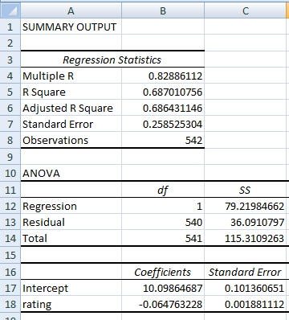
Using noise to predict ln(price) instead of price:
Q3: 95% pred. interval for price at 0 db:
This is a question about individual dishwashers…

Slide 7
Intermediate calculations:
SE(b₀) = 0.10136
→ SE_{Y|X}*sqrt(1/n+…) = 0.101
→ sqrt(1/n+…) = 0.392
→ SE(indiv Y at x=0) = SE_{Y|X}*sqrt(1+1/n+…) = 0.2777

Slide 8
Using noise to predict ln(price) instead of price:
Q3: 95% conf. interval for price at 0 db:
95% PI for β₀ = 9.553 to 10.644
→ 95% PI for price
= e^{9.553} to e^{10.644}
= $14,089 to $41,945
Note: this may not be a realistic estimate of what people would actually pay, but it IS what is predicted by the model

Slide 9
Using noise to predict ln(price) instead of price:
Q4: correlation between noise rating and ln(price)?
r = –0.8289 (we know r is negative because slope is negative)

Slide 10
Using noise to predict ln(price) instead of price:
Q5: 95% CI for indiv price at 45 dB?
pred ln(price) = 7.184
SE(Y at x=45) = 0.2593 (since we know , SD(X), and SE_{Y|X})
95% PI for average ln(price) = 6.675 to 7.693
→ 95% PI for average price = $792 to $2194

Slide 11
Questions about dishwashers?

Slide 12
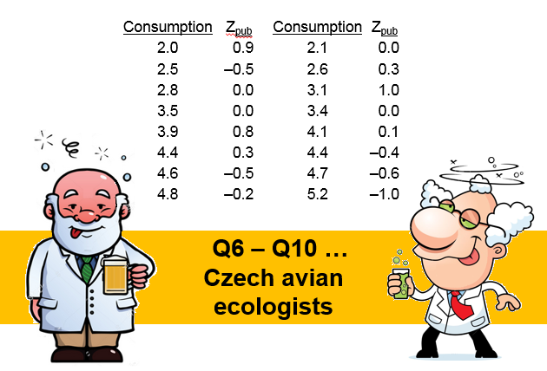

Slide 13
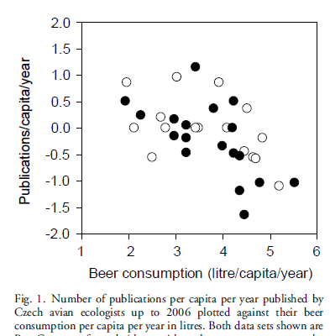


Q6: regression line using consumption to predict Z?
pred Z = 1.045 – 0.2844 cons.
Q7: correlation?
Q8: SE_{Y|X}?
Q9: number of residuals > 0?
r = –0.52
n = 6

Slide 14
Q10. Does this study show that increased beer consumption will result in lower publications, on average?
Yes, since this was a random sample.
No, since the sample size was small (only n = 16)
Yes, since this was a randomized experiment, and randomized experiments can prove causality.
No, since this was an observational study, and observational studies could have confounding factors.
Yes, since the correlation was negative.

Slide 15
Q10. Does this study show that increased beer consumption will result in lower publications, on average?
Yes, since this was a random sample.
No, since the sample size was small (only n = 16)
Yes, since this was a randomized experiment, and randomized experiments can prove causality.
No, since this was an observational study, and observational studies could have confounding factors.
Yes, since the correlation was negative.

Slide 16
There IS a negative correlation between beer consumption and # of publications
Perhaps beer drinking did cause ecologists to publish fewer papers
… or perhaps not getting published caused ecologists to drink (out of depression) …
… or perhaps there are other factors (maybe authors who drink more have different cultural backgrounds [e.g., name] )

Slide 17
Before concluding that A causes B, ask
… could the results be just coincidence?
Perform an appropriate test of stat. significance
… could it be that, actually, B causes A?
Could not getting published causes drinking?
… could it be that there is a third factor that relates to both A and B?
Might there be sub-cultures in the Czech Republic that drink more, and people from those sub-cultures experience bias when trying to publish?
Be cautious before concluding causality!

Slide 18
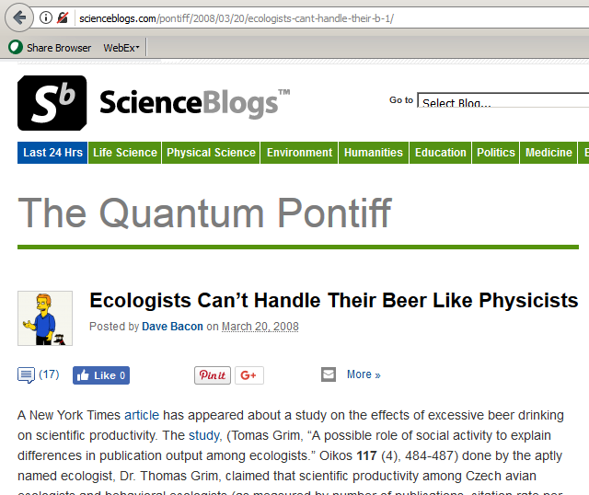
The article has received criticism

Slide 19
The article has received criticism
“[N]ote that
consumption rates are huge for the outliers
there was no description of the methodology for choosing the survey sample
any effect, if it is there, is coming from the very high end of the beer consumption spectra
linear regression seems like a spectacularly poor notion of how beer drinking has an effect on scientific output
no attempt to separate out the effect of different quality universities and the different geographic consumption levels was made.

Slide 20
The article has received criticism
Association is not necessarily causation!
Beware of possible confounding factors when analyzing results from observational studies

Slide 21
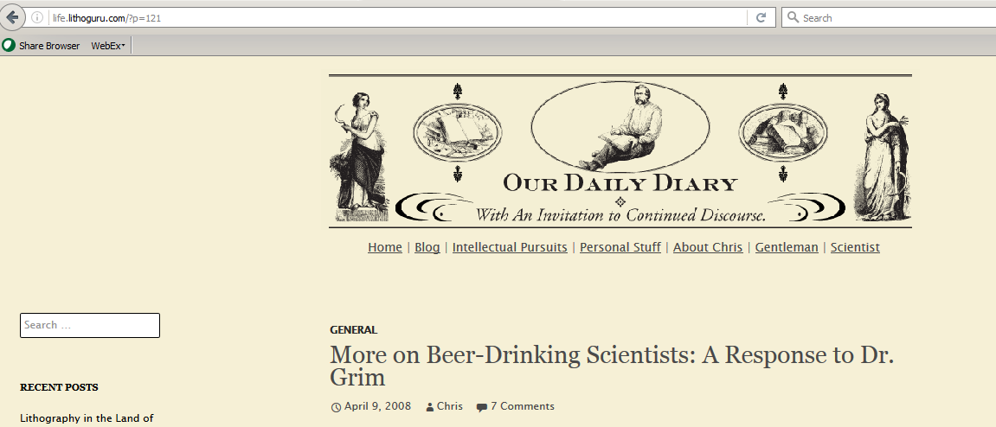
http://life.lithoguru.com/?p=121
PS The author got touchy when his work was questioned

Slide 22
Chris Mack: “I complained in my first post that correlation does not imply causation.
Dr. Grim correctly pointed out that the word “ ‘causes’ or ‘causation’ does not appear in my paper. I am not that stupid.”
He then suggested that I “read more carefully, please.”

Slide 23
But I have read his paper very carefully…
He states in his paper that “human cognitive performance during and after drinking is decreased”, that it “significantly decrease[s] cooperativeness” and the “effects of alcohol use are well known to decrease mental and working performance in general” …
His recent comments on this blog also confirm his adherence to one causation theory, adding that hangovers impede productivity (even though his survey provided no evidence of drunkenness or hangovers on the part of the participants).

Slide 24
Dr. Grim called into question my statistical abilities. His advice to me: “PLEASE, read some statistical textbook first”.
I read quite a few in 2006 when I taught a graduate-level statistics course at the University of Notre Dame
I [taught] my students that statistics are often the last refuge of the mediocre scientist
When systematic error (bias in the data) is greater than random error, the use of statistics is a waste of time [and] can give a false sense that one’s conclusions are scientifically rigorous

Slide 25
“Simple fact: Dr. Grim surveyed a small number of fellow Czech ornithologists in what was probably great fun, but definitely bad science.
Dr. Grim himself described his paper as “half-joke-half-study”.
Now, I’m the first person to appreciate a good joke, especially at the expense of us scientists.

Slide 26
However, Dr. Grim failed to mention the “half-joke” part of the equation in his published paper, preferring instead to pass off his bit of fun as real science.
As such, publication of his paper in a scientific journal borders on the unethical.
Dr. Grim must now own up to his joke or face digging an even deeper hole for himself.”
Lesson #1: Association is not causation …

Slide 27
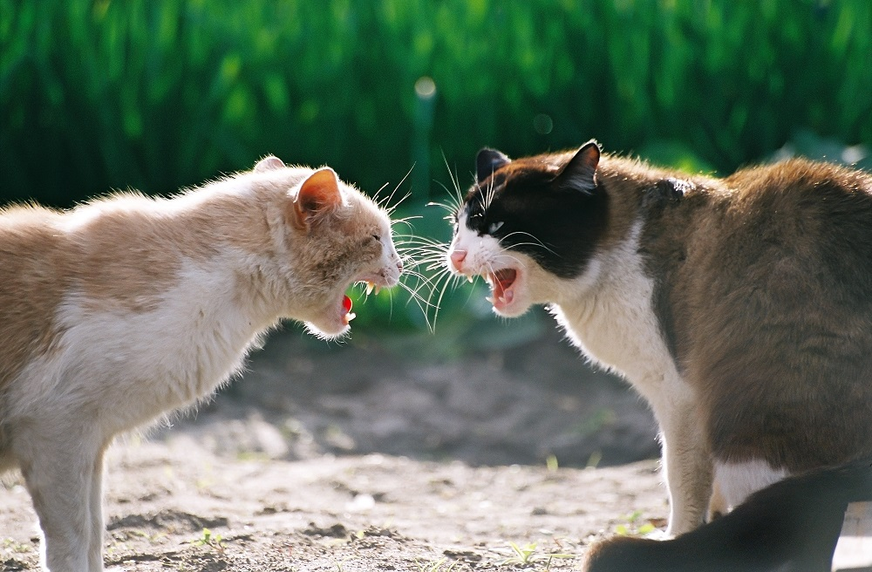
Lesson #2: statisticians can be quite snarky
Questions on HW10?

